Slide 1
Large Language Model

Slide 2
Agenda
Seq2Seq models recap
Transformers
Attention mechanism
BERT
Large Language Models
ChatGPT

Slide 3
Natural Language Processing (NLP) is a field of Artificial Intelligence (AI) that makes human language intelligible to machines.
NLP combines the power of linguistics and computer science to study the rules and structure of language, and create intelligent systems capable of understanding, analyzing, and extracting meaning from text and speech.

Slide 4
NLP tasks
Text classification
Food was awesome, and the waiter was very responsive
Discriminative tasks
Positive
Text → ?
Intent classification
I want to book a flight from Canada to the USA, but my card was declined
Intent to book a flight

Slide 5
NLP tasks
Entity Extraction
I want to book a flight from Canada to the USA, but my card was declined
Discriminative tasks
Canada, USA
Text → ?

Slide 6
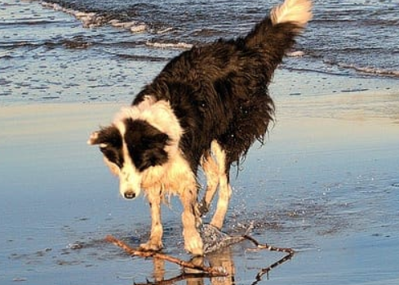
NLP tasks
Auto-completion
The truth is
I don’t have a lot of creative advice to give
Generative tasks
? → Text
Caption Generation
Photo of a dog at the beach

Slide 7
NLP tasks
Machine Translation
I bought a sweet persimmon in the store
Ich kaufte eine sube persimone im laden
Seq2Seq tasks
Text → Text
Text summarization
The ancient magician chanted the mystical words, and the rabbit vanished into thin air
A magician uses magic to make a rabbit disappear

Slide 8
Timeline
Task specific approaches
Word2vec
(2013)
RNN (1997, 2014)
BPE
(1994, 2016)
Attention (2015)
Transformers
(2017)
BERT (2018)
GPT3
(2020)

Slide 9
Sequence to Sequence models

Slide 10
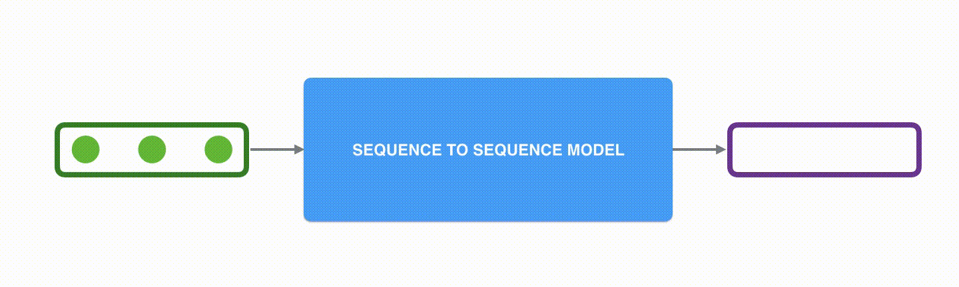
Sequence to sequence models
A sequence-to-sequence model is a model that takes a sequence of items (words, letters, features of an images…etc) and outputs another sequence of items. A trained model would work like this

Slide 11
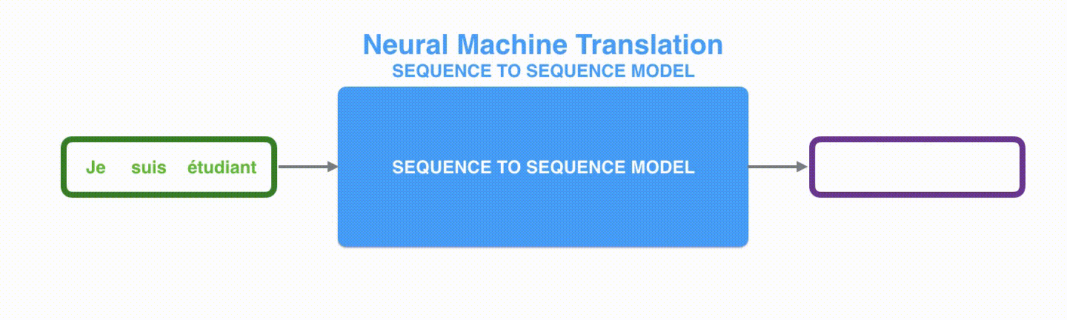
Sequence to sequence models

Slide 12
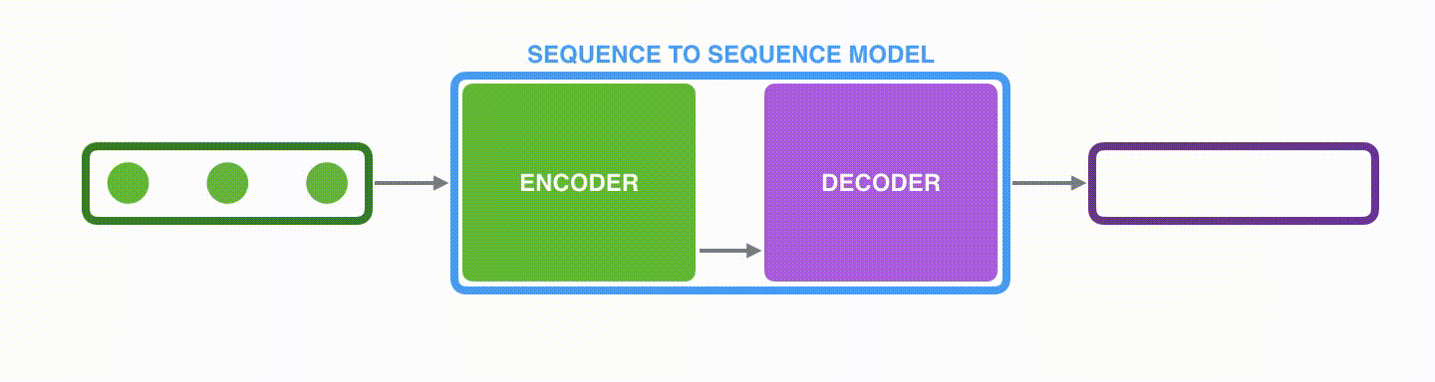
Sequence to sequence models
Under the hood, the model is composed of an encoder and a decoder. The encoder processes each item in the input sequence, it compiles the information it captures into a vector (called the context). After processing the entire input sequence, the encoder sends the context over to the decoder, which begins producing the output sequence item by item

Slide 13
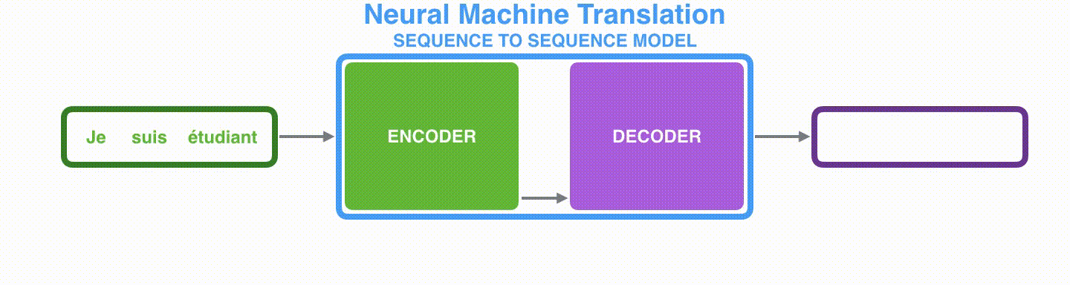
Sequence to sequence models

Slide 14
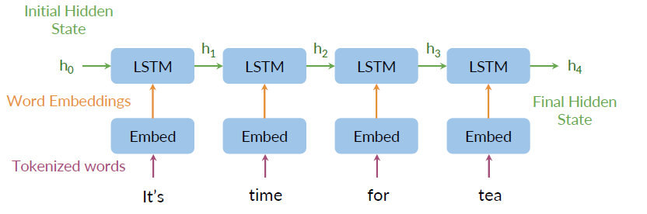
Sequence to sequence encoder

Slide 15
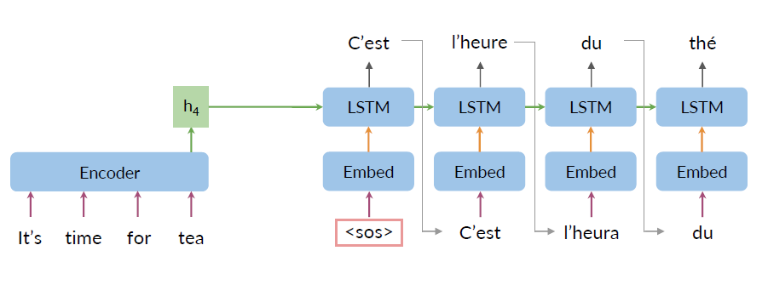
Sequence to sequence decoder

Slide 16
Seq2Seq bottlenecks
Loss of information
No parallel computing
Vanishing gradient

Slide 17

Attention is all you need!

Slide 18
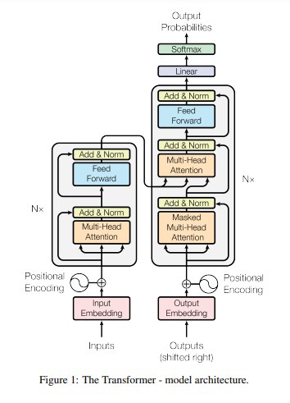
Attention is all you need

Slide 19
Attention is all you need
An attention function can be described as mapping a query and a set of key-value pairs to an output, where the query, keys, values, and output are all vectors.
The output is computed as a weighted sum of the values, where the weight assigned to each value is computed by a compatibility function of the query with the corresponding key.

Slide 20
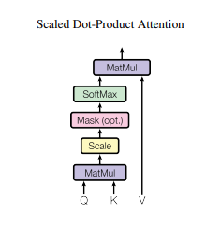
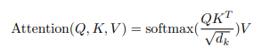
Attention is all you need

Slide 21
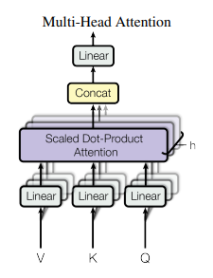
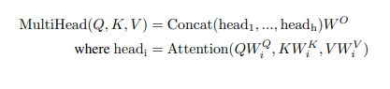
Attention is all you need
Multi-head attention allows the model to jointly attend to information from different representation subspaces at different positions. With a single attention head, averaging inhibits this.

Slide 22
Transformers

Slide 23

Neural Machine Translation
Input
Output
Je suis etudiant
I am a student

Slide 24
Neural Machine Translation
I am a student
Encoders
Decoders
Je suis etudiant

Slide 25
Neural Machine Translation
I am a student
Encoder
Decoder
Encoder
Decoder
Encoder
Decoder
Encoder
Decoder
Encoder
Decoder
Je suis etudiant

Slide 26
Encoder
Feed Forward Neural Network
Self Attention

Slide 27
Encoder-Decoder
Feed Forward Neural Network
Encoder-Decoder attention
Feed Forward Neural Network
Self Attention
Self Attention
Encoder
Decoder
Notes:
The encoder’s inputs first flow through a self-attention layer – a layer that helps the encoder look at other words in the input sentence as it encodes a specific word. We’ll look closer at self-attention later in the post.
The outputs of the self-attention layer are fed to a feed-forward neural network. The exact same feed-forward network is independently applied to each position.
The decoder has both those layers, but between them is an attention layer that helps the decoder focus on relevant parts of the input sentence (similar what attention does in seq2seq models).

Slide 28
Flow of tensors
Feed Forward Neural Network
z1
z2
z3
Self Attention
X1
X2
X3
Je
suis
etudiant
Notes:
The encoder’s inputs first flow through a self-attention layer – a layer that helps the encoder look at other words in the input sentence as it encodes a specific word. We’ll look closer at self-attention later in the post.
The outputs of the self-attention layer are fed to a feed-forward neural network. The exact same feed-forward network is independently applied to each position.
The decoder has both those layers, but between them is an attention layer that helps the decoder focus on relevant parts of the input sentence (similar what attention does in seq2seq models).

Slide 29
Encoder #2
r1
r2
r3
Encoder #1
Feed Forward Neural Network
z1
z2
z3
Self Attention
X1
X2
X3
Je
suis
etudiant
Notes:
The encoder’s inputs first flow through a self-attention layer – a layer that helps the encoder look at other words in the input sentence as it encodes a specific word. We’ll look closer at self-attention later in the post.
The outputs of the self-attention layer are fed to a feed-forward neural network. The exact same feed-forward network is independently applied to each position.
The decoder has both those layers, but between them is an attention layer that helps the decoder focus on relevant parts of the input sentence (similar what attention does in seq2seq models).

Slide 30
Self-Attention
The animal didn't cross the street because it was too tired
What does “it” in this sentence refer to?
Animal
Street

Slide 31
Embeddings
X1
X2
q1
q2
Queries
W^{Q}
k1
k2
Keys
W^{K}
v1
v2
Values
W^{V}

Slide 32

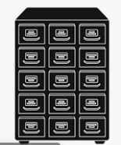

Find relevant books in a library. Asks questions to identify which books are most important for a task
Queries
Contains information about every book in library. Librarian uses catalog to understand the books better
Keys
Actual books (info). Librarian (query) guided by the catalogue (key) identifies the book (value)
Values

Slide 33
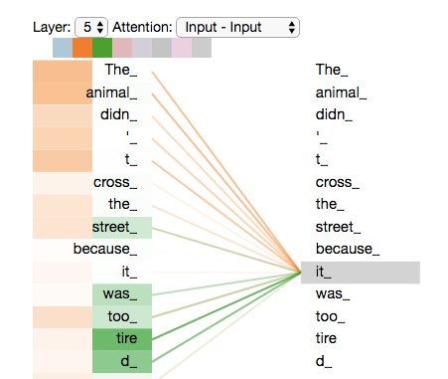
Self-Attention

Slide 34
Embeddings
X2
X1
Queries
q1
q2
Keys
k1
k2
Values
v1
v2
Score
q1.k1 = 112
q1.k2 = 96

Slide 35
Embeddings
X2
X1
Queries
q1
q2
Keys
k1
k2
Values
v1
v2
Score
q1.k1 = 112
q1.k2 = 96
Softmax
Softmax(112/8) = 0.88
Softmax(112/8) = 0.12

Slide 36
Embeddings
X2
X1
Queries
q1
q2
Keys
k1
k2
Values
v1
v2
Softmax
0.88
0.12
Attention
z1
z2

Slide 37
X
Q
W^{Q}
X
W^{K}
K
X
V
W^{V}

Slide 38
Q
K^{T}
V
softmax
-------------------------------------------------------------------
square root(dimension of k)
Z

Slide 39
Multi-headed Self-Attention
Attention head Z0
Attention head Z1
Attention head Zn
…….

Slide 40
Encoder flow
Input
Embed
Create weight matrices
Calculate attention
Concatenate results
W^{Q}
Q
Z
X
W^{K}
K
Big data and machine learning
W^{T}
T
Z
W₀
Z
W^{Q}
Q
W^{K}
K
W^{T}
T

Slide 41
Positional encoding
Input
Je
suis
etudiant
Embeddings
X1
X2
X3
Positional encoding
t1
t2
t3
Embedding with time signal
X1
X2
X3

Slide 42
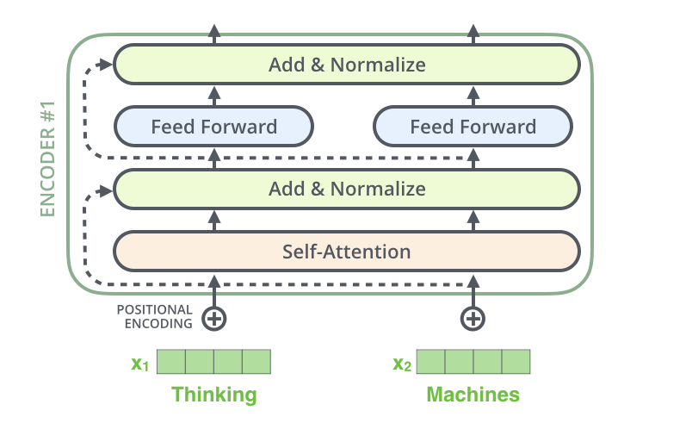
Encoder block

Slide 43
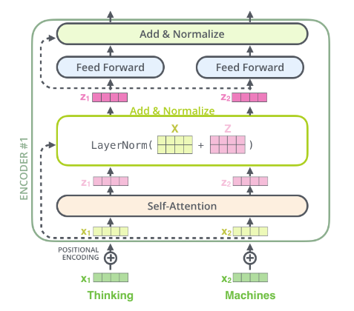
Encoder block

Slide 44
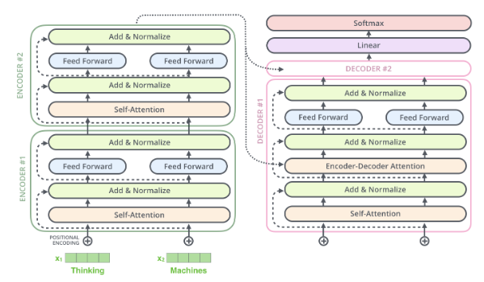
Encoder – decoder block

Slide 45

Transformer decoding

Slide 46

Transformer decoding

Slide 47
Transformer types
Encoder only models
Decoder only models
Encoder-decoder models
ALBERT
BERT
DISTILBERT
ELECTRA
RoBERTa
CTRL
GPT
GPT2
GPT3
Transformer XL
BART
Marian
T5
Llama2

Slide 48
BERT

Slide 49
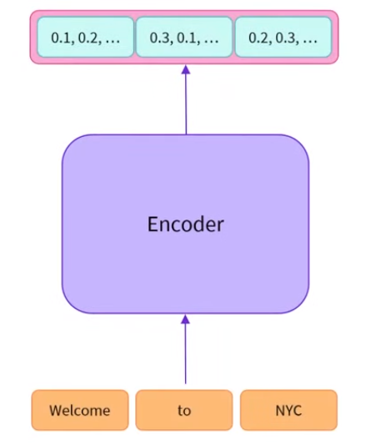
BERT
A bidirectional transformer pre-trained using a combination of masked language modeling objective and next sentence prediction on a large corpus comprising the Toronto Book Corpus and Wikipedia

Slide 50
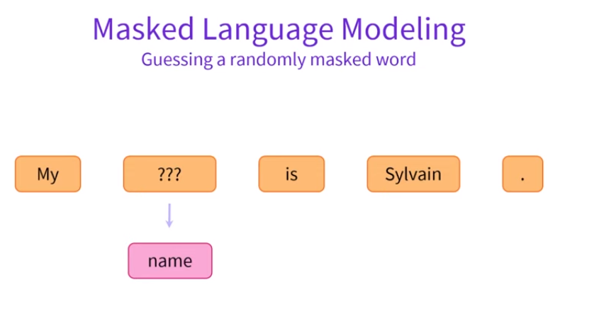
BERT

Slide 51
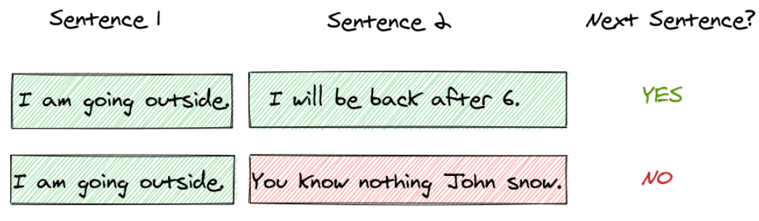
BERT
Next Sentence Prediction

Slide 52
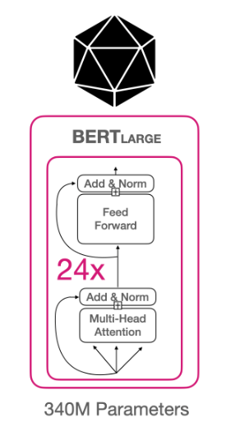
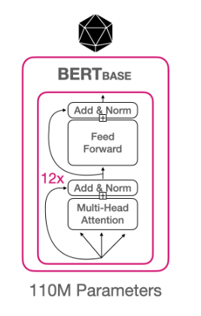
BERT Architecture

Slide 53
BERT Architecture

Slide 54
GPT 2

Slide 55
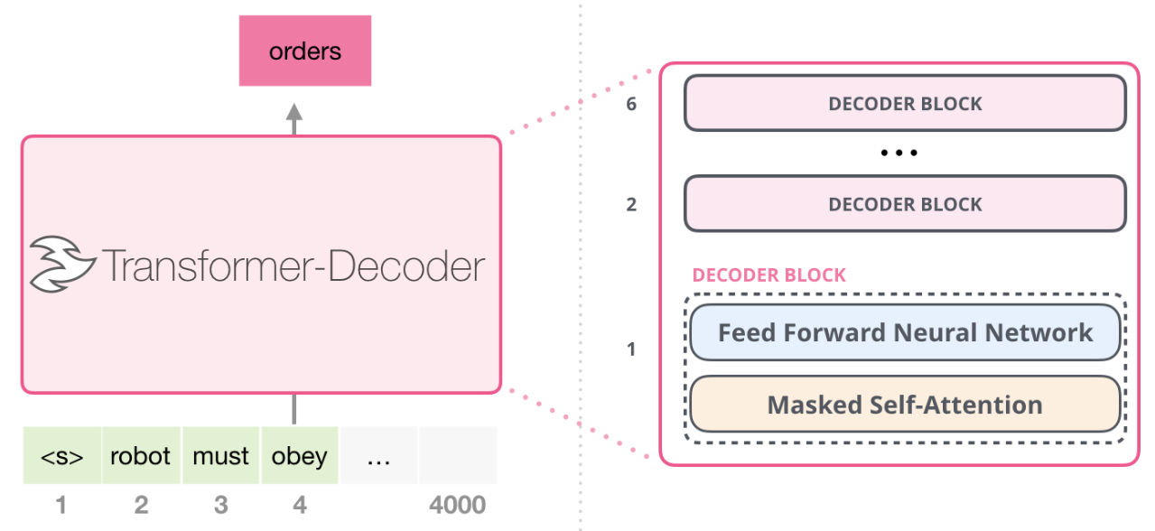
GPT2
GPT is a language model with transformer based architecture that is trained to take input text and transform it into what it predicts the most useful result will be

Slide 56
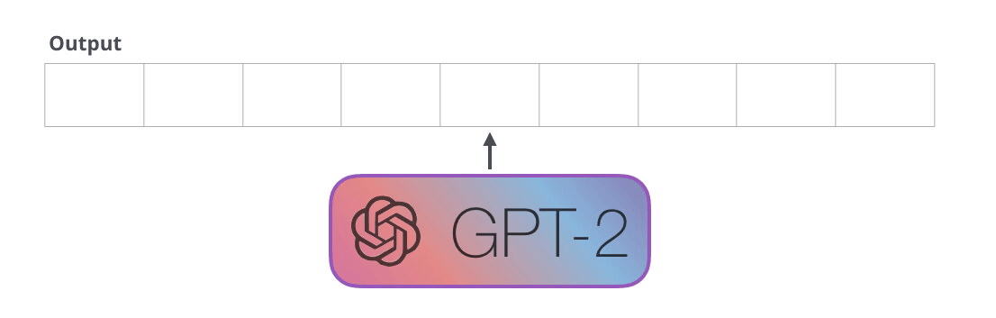
GPT2
GPT-2 is built using transformer decoder blocks
Like traditional language models GPT-2 outputs one token at a time

Slide 57

GPT2
Imagine GPT-2 as a storyteller who is telling a bed time story to a kid
This storyteller's job now needs to be creative, so he starts with an initial plot line and writes one word at a time.
The storyteller starts with the first word. They carefully select it, considering the story's introduction and the tone they want to set
They remember everything they've written so far in the story, as well as the context of the current scene. This memory allows them to ensure that the story flows logically.

Slide 58
GPT2
Once they've written the first word, it's time for the second word. Here's where autoregression comes in
The storyteller decides the next word in the story based on the context provided by the previous words. It's like they're predicting the next word in the story to make sure it makes sense and keeps the narrative cohesive
The storyteller continues this process, word by word, predicting and writing the next word based on what they've written before
They ensure that the sentences flow smoothly and that the story remains engaging.
This process of autoregression continues until the storyteller decides to stop. The story can be as short or as long as needed, and the storyteller maintains the coherence and consistency throughout

Slide 59
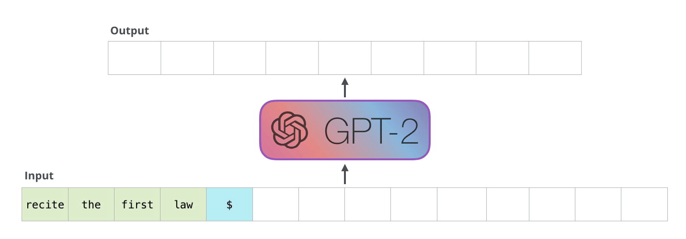
GPT2

Slide 60
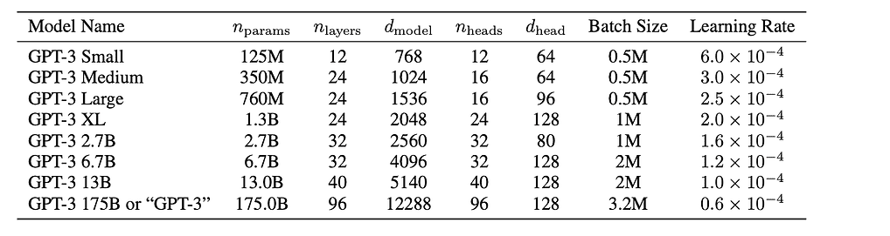
GPT2 Architecture
GPT is a language model with transformer based architecture that is trained to take input text and transform it into what it predicts the most useful result will be

Slide 61
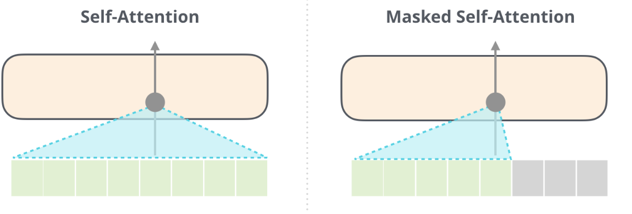
GPT Architecture
A normal self-attention block allows a position to peak at tokens to its right
Masked self-attention prevents peaking at tokens at the right

Slide 62
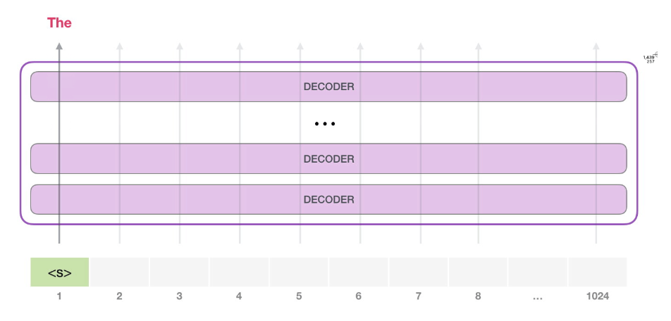
GPT2 Architecture
The model only has one input token, so that path would be the only active one
The token is processed successively through all the layers, then a vector is produced along that path
The vector can be stored against model vocabulary (50K words for GPT2)
In this case we selected the token with the highest probability, ‘the’.

Slide 63
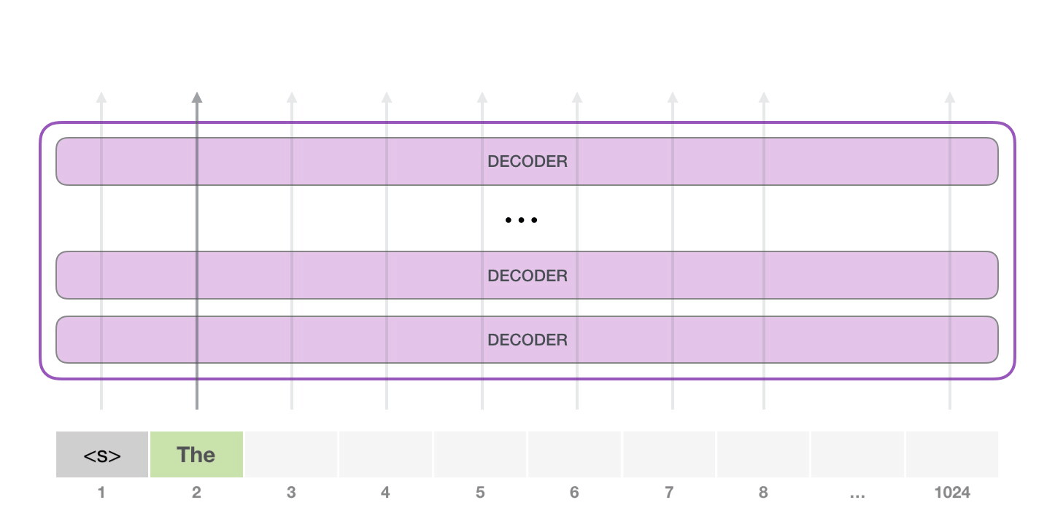
GPT2 Architecture
However, there is a catch!
If we keep on looking for the highest probability work, we might get stuck in a loop of repetitive words
The same can happen here. GPT-2 has a parameter called top-k that we can use to have the model consider sampling words other than the top word (which is the case when top-k = 1)

Slide 64
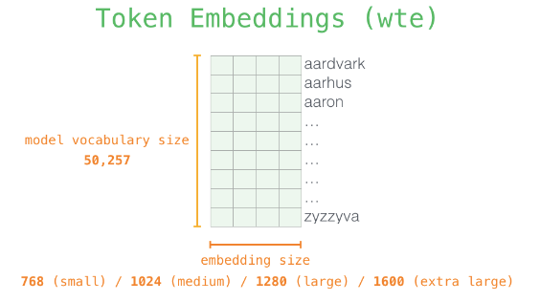
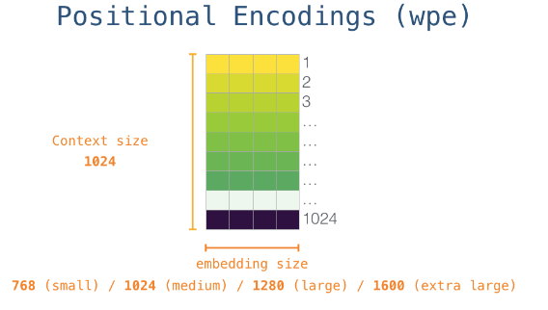
GPT2 Architecture
Positional encoding – a signal that indicates the order of the words in the sequence to the transformer blocks

Slide 65
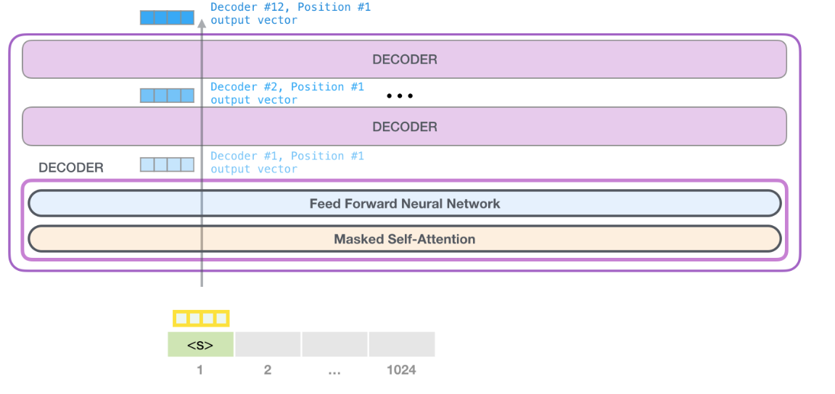
Putting all together

Slide 66
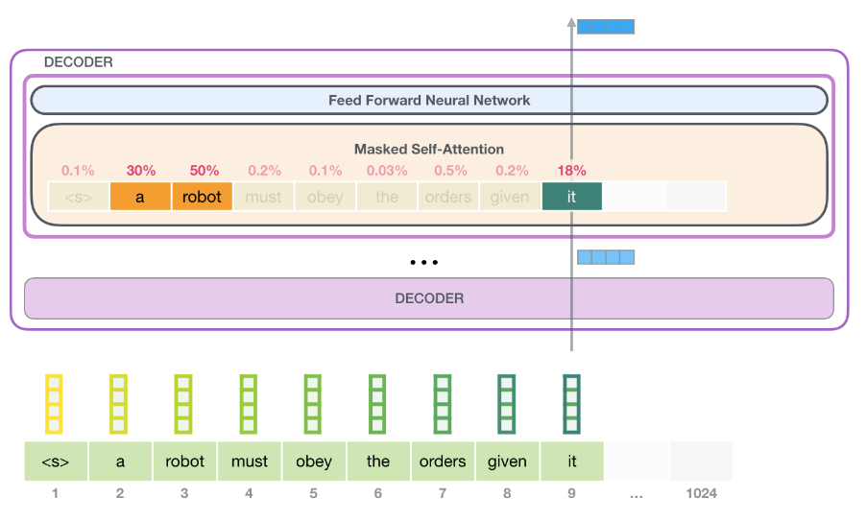
GPT Architecture

Slide 67
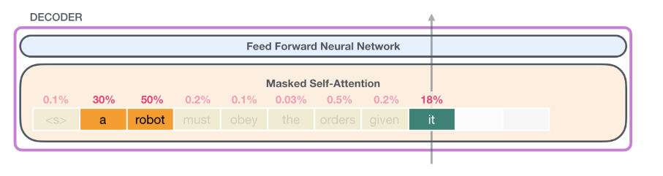
GPT Self attention

Slide 68
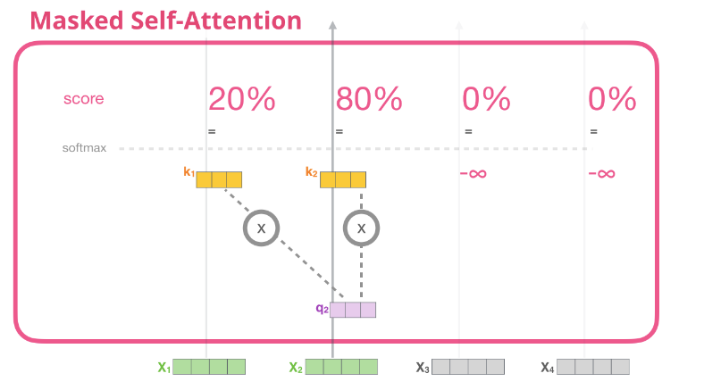
Masked Self attention

Slide 69
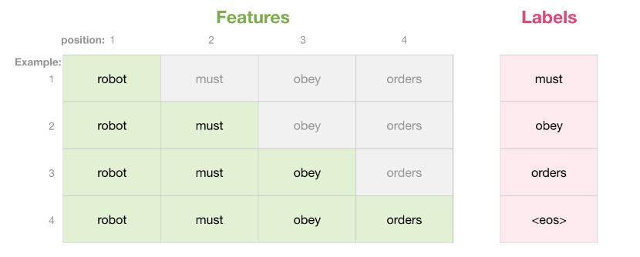
Masked Self attention

Slide 70
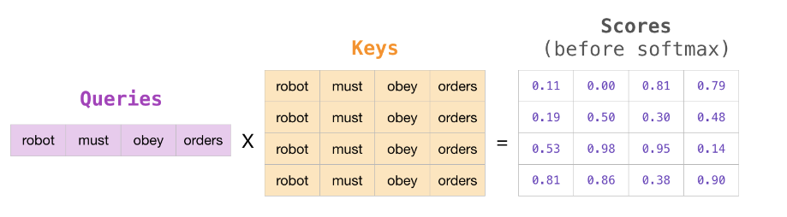
Masked Self attention

Slide 71
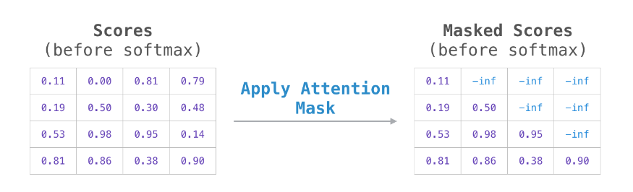
Masked Self attention

Slide 72
GPT 3

Slide 73
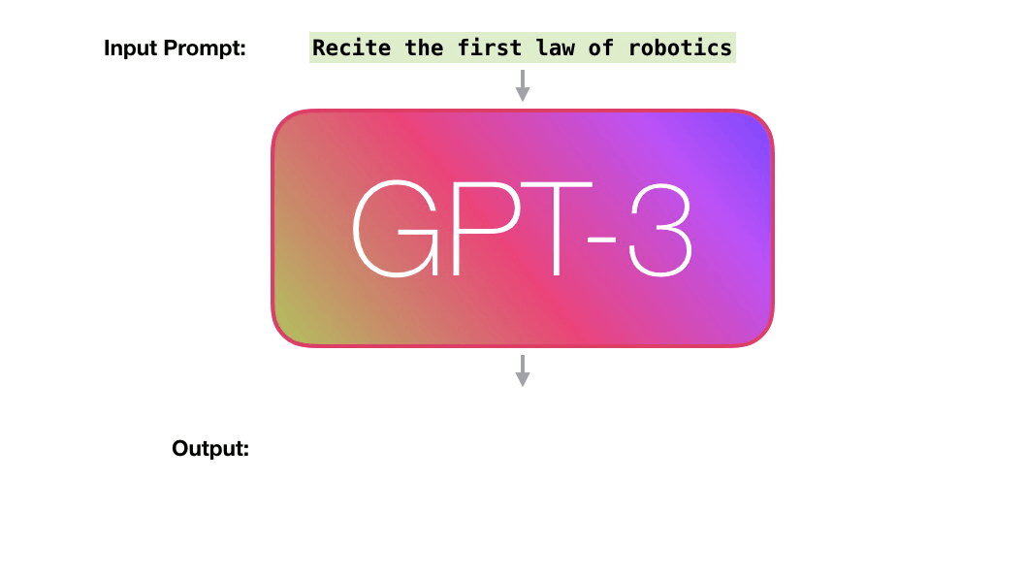
GPT 3
GPT-3, or the third-generation Generative Pre-trained Transformer, is a neural network machine learning model trained using internet data to generate any type of text.
Developed by OpenAI, it requires a small amount of input text to generate large volumes of relevant and sophisticated machine-generated text

Slide 74
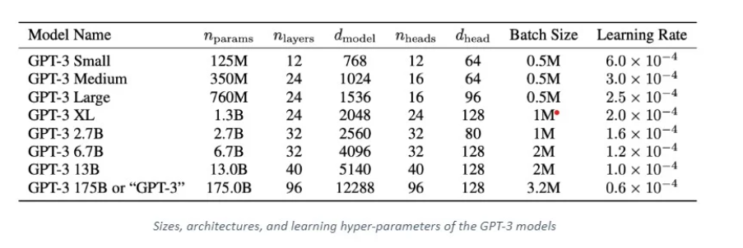
GPT 3 architecture

Slide 75
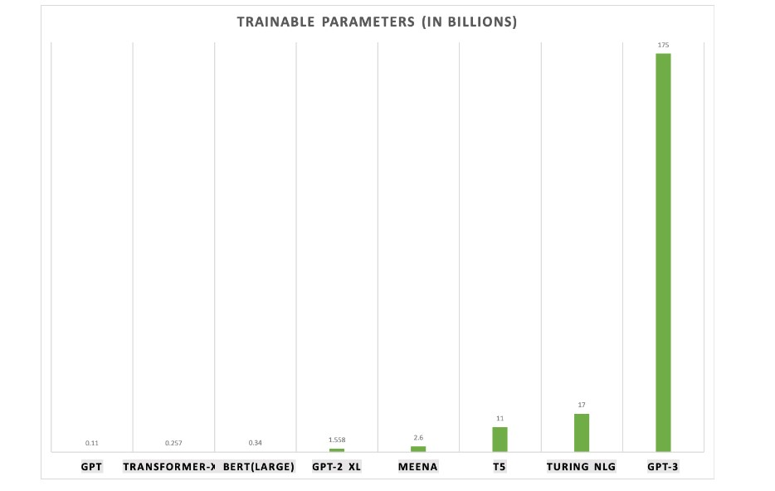
GPT 3 Trainable Parameters
175 B
17 B
11 B
0.34 B
1.55 B
2.6 B
0.11 B
0.25 B

Slide 76
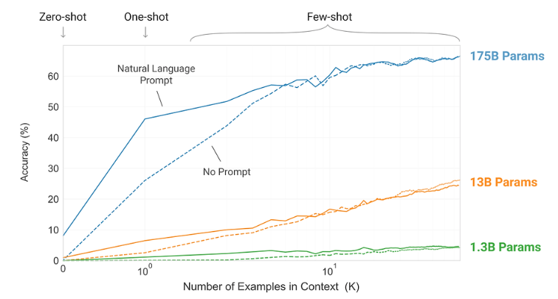
GPT 3 performance

Slide 77
GPT 3 models
GPT-1
GPT-2
GPT-3
June’18
Feb’19
May’20
InstructGPT
Mar’22
ChatGPT
Nov’22

Slide 78
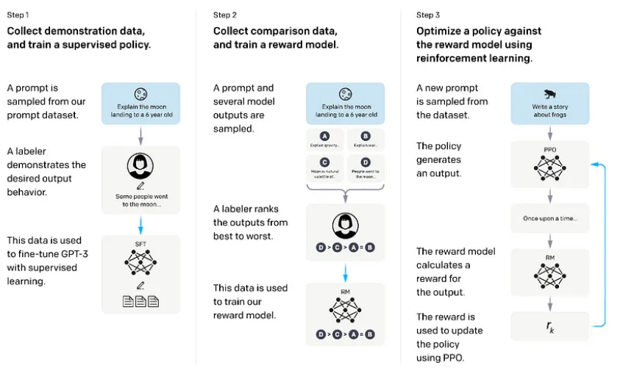
InstructGPT
Fine-tuning using dataset of human labeler demonstrations of the desired model behavior
Applied Reinforcement Learning Human Feedback (RLHF) to align language models with user intent on a wide range of tasks by fine-tuning with human feedback

Slide 79
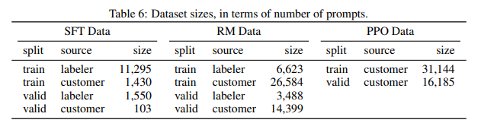
InstructGPT
Supervised fine-tuning Collect human demonstration data of desired behavior given input prompt to fine-tune GPT-3 model

Slide 80
InstructGPT
Train reward model Collect a dataset of human rankings of model outputs given prompt to train a reward model. Goal is to predict which output is preferred by human

Slide 81
InstructGPT
Further fine-tune model using Proximal Policy Optimization (PPO) algorithm

Slide 82


Slide 83
